Slide 1
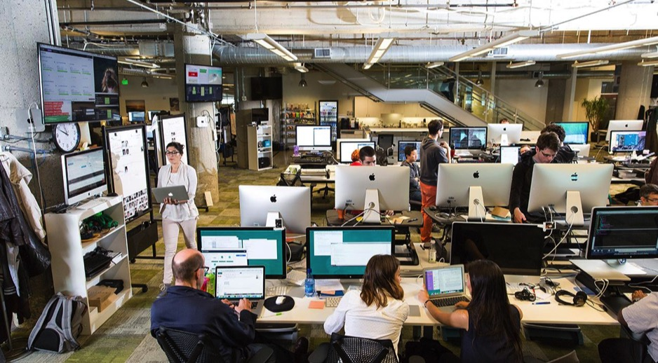

Transforming how the world builds software

Slide 2
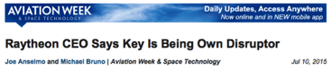
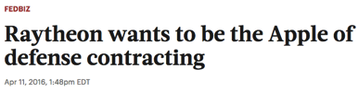
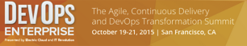
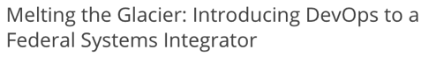

Slide 3

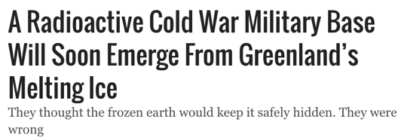

Slide 4




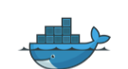

Request VMs
Request Network
Request Software Install
Request Database
Random Network Troubleshooting
14
4
4
8
6
11
40
14
60
2
Random Middleware/OS Troubleshooting
Develop App
User Acceptance Testing
QA/Production Deploy Pipeline
Scale Up/Down

Slide 5



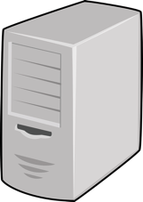

DEV
TEST
PROD

Slide 6
What’s Important to Raytheon
GBS –Solve data quality/leakage/compliance issues with modern application and data microservices. Open up platform marketplace to BU consumers. Allow for constant iteration. Reduce risk. Improve quality of life.
RMS –Move from current (25-30) IT Ticket based app deployment process, reduce or eliminate the IBM middleware management outsourcing service.
GEA - "A platform that supports continuous everything DevOps is a key theme of Raytheon's end to end SDLC value stream enablement that helps us move from a variety of SDLC methodologies (e.g. RAD, iterative, waterfall) towards one common agile business outcome based (e.g. "Deliver Mission/Business solutions with critical capabilities, 50% cheaper, 50% faster with 100% show stopper and critical defects resolved") approach .”
IIS – Increase developer productivity, cloud elasticity for dev environments. Improve management and immutability of applications in engineered solutions portfolio to reduce IIS consulting cost, speed security patching. Create reference architecture for new cloud native apps. Align to Air Force Research Labs, National Geospatial-Intelligence Agency cloud native infrastructure for new bids.

Slide 7
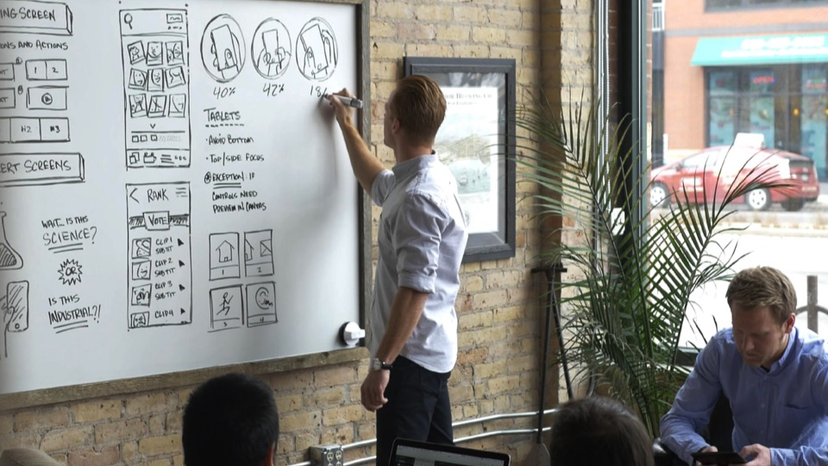
75%
of application development supporting digital business will be built not bought by 2020
Source: Gartner

Slide 8
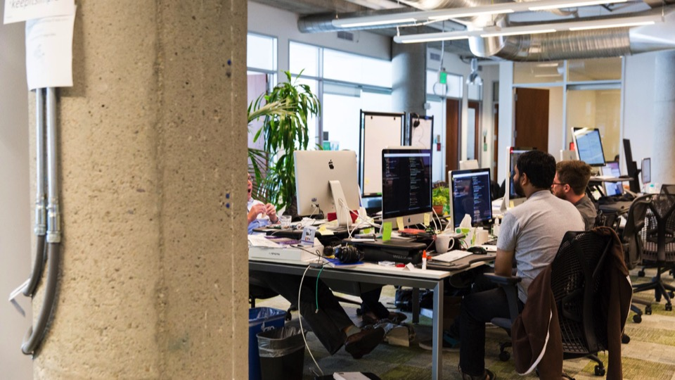




KEY TRENDS
The cost and ubiquity of computing enables cloud native software companies to reshape the world
Mobile devices and connectivity
Near-free computing costs
Global scale of operations
Ubiquity of embedded sensors
8

Slide 9
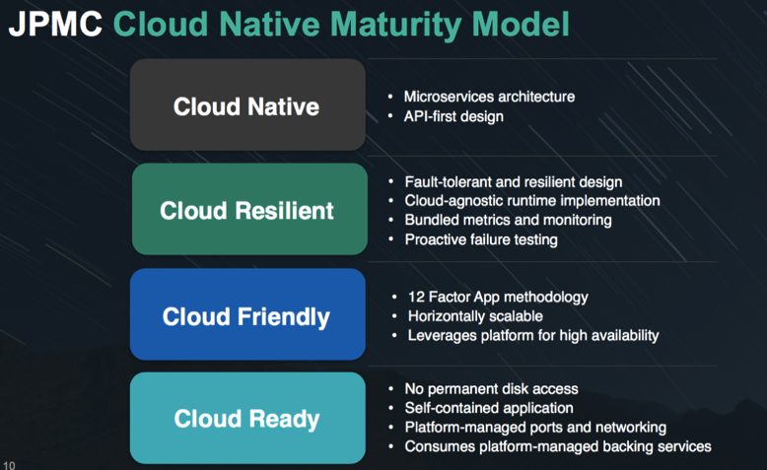

Slide 10
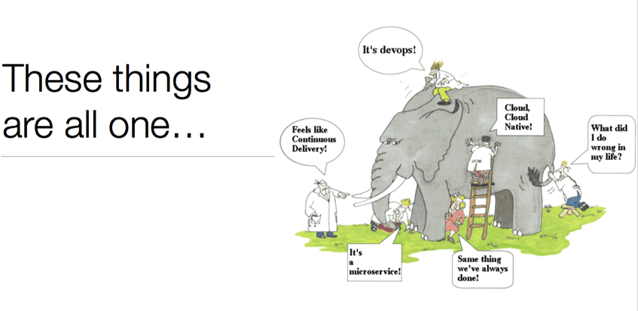

Slide 11

Continuous
Delivery
DevOps
Cloud Native
Micro services
Containers

Slide 12
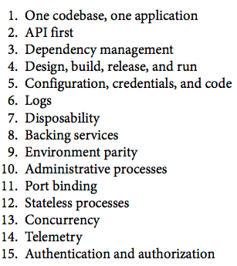
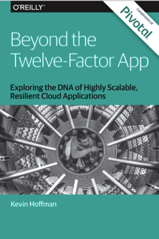
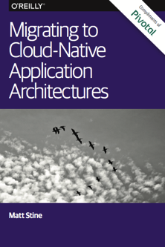
12factor.net

Slide 13
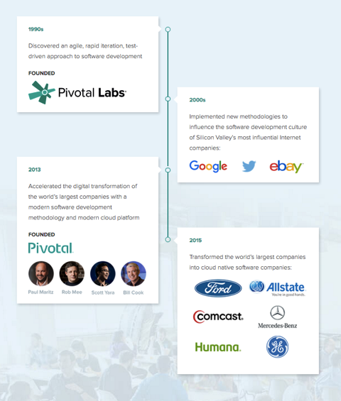

Paul Maritz “Cloud is about how computing is done, not where”
Rob Mee "Productive teams are happy teams”
Eric Ries, Author of “Lean Startup”
Ben Black, Director of IoT - Creator of Amazon Web Services
Josh McKenty, Field CTO - OpenStack Co-Founder, NASA Andrew Clay Shafer, - Co-Founder Puppet Labs

Slide 14




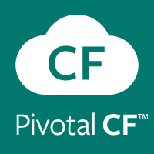

PIVOTAL LABS
Agile product development, practices and collaboration for product and culture transformation
PIVOTAL BIG DATA SUITE
PIVOTAL CLOUD FOUNDRY
Modern, open, highly parallelized platform
Modern, open, highly automated cloud native platform

Slide 15
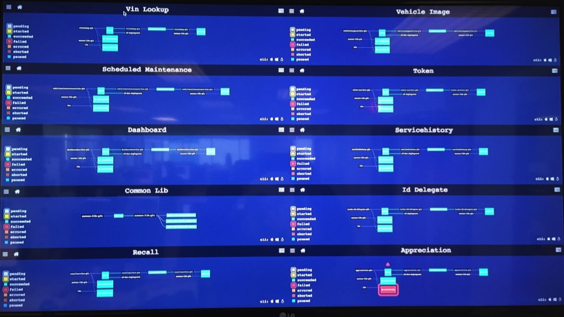
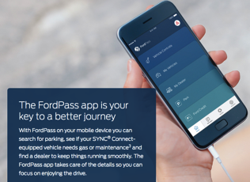

Slide 16
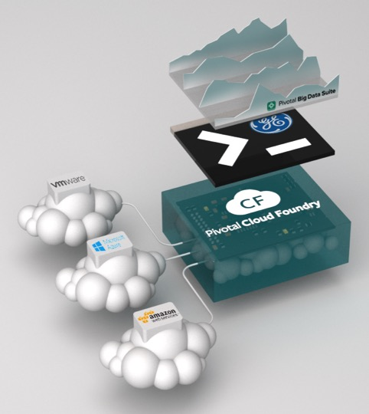
CASE STUDY: GENERAL ELECTRIC
The engine behind GE Predix.io
Challenge:
Need to combine technology and software to drive zero downtime for customers across multiple business units to drive profitability
Advance DevOps and agile culture, to meet business unit and market demand while avoiding a splintered process for developing and deploying apps
Desire to create microservices architecture to be leveraged across multiple BUs in different industries
Solution:
Leverage Pivotal Cloud Foundry microservices architecture out of box instead of incurring technical debt of a custom built platform
Allows customer to focus on developing business capabilities of each industry specific app & differentiating microservices, realizing efficiencies and more rapid development overall

Slide 17

“If you went to bed last night as an industrial company, you’re going to wake up a software and analytics company.”
Jeff Immelt
CEO, General Electric
Source: User Summit (2014)
Pivotal — Confidential

Slide 18
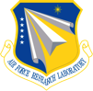

Air Force Research Laboratory Makes Leap to Transform Department of Defense Software Development and Deployment
Challenge:
Build cloud native platforms and provide them as a service to U.S. Department of Defense entities.
Lack of its own development arm.
DOD IT services is unreliable and has expensive, very long deployment cycles.
Desire to drastically transform how the DOD runs software.
Solution:
Introduce the concept of cloud native platform development and deployment to Department of Defense entities.
Offer platform to the broader DOD community and use profit to drive research.
Customers will build apps on top of PCF. One example is an intelligence system that will pull technological and scientific data in multiple languages, index it and making it searchable.
Pivotal Solution includes: Pivotal Cloud Foundry

Slide 19


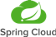
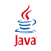
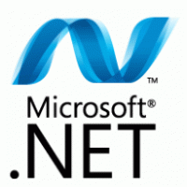
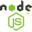





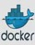

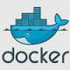


DIY vs Pivotal Cloud Foundry
Discovery
Load balancing
Distributed tracing
API gateway
Microservices
Services
Multi-tenancy
CI/CD
Logging and Monitoring
Autoscaling
App Orchestration
Routing
Health Checking
Scaling
Container networking
Metrics
Storage
Container Scheduling/Orchestration
Pivotal Cloud Foundry
Immutability
Availability Zones
S3, EBS, EFS
Container Runtime
DIY Platform
Cloud Portability
Availability Zones
S3, EBS, EFS
Security groups
IPSec
Cloud Orchestration
Provisioning and Patching
Host OS
App Servers
Runtime
Configuration Management
IaaS

Slide 20


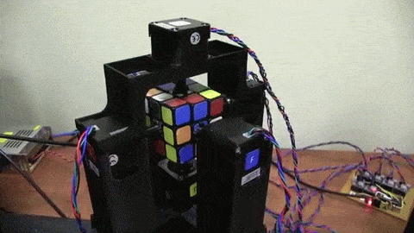



DIY vs Pivotal Cloud Foundry
Discovery
Load balancing
Distributed tracing
API gateway
Microservices
Services
Multi-tenancy
CI/CD
Logging and Monitoring
Autoscaling
App Orchestration
Routing
Health Checking
Scaling
Container networking
Metrics
Storage
Container Scheduling/Orchestration
Immutability
Availability Zones
S3, EBS, EFS
Container Runtime
Cloud Portability
Availability Zones
S3, EBS, EFS
Security groups
IPSec
Cloud Orchestration
Provisioning and Patching
Host OS
App Servers
Runtime
Configuration Management
IaaS

Slide 21
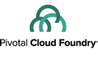
DEVELOPMENT
OPERATIONS
Multiple
Languages
App Deployment
& Management
CI/CD Tools,
ID, Security
Microservices
Support
Health, Metrics
Patching
Availability
Services
Marketplace
Native
User Provided
Partner
Visibility &
Administration
Apps & Platform
Dashboards
VALUE LINE
Operating
System
Container Orchestration
Cloud API

Slide 22
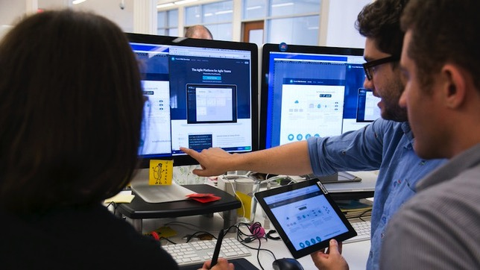
“How much value do you get from managing operating systems”

Slide 23
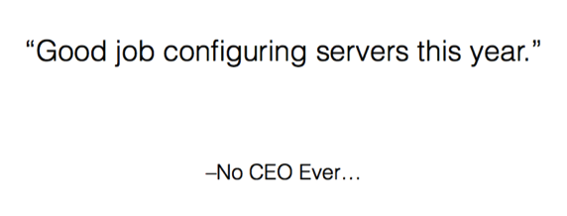

Slide 24
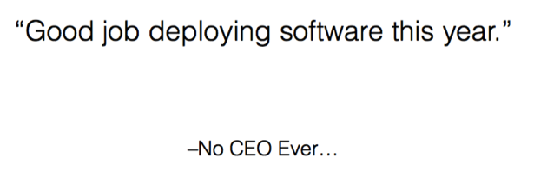

Slide 25
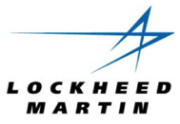

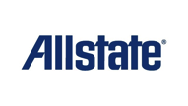

“App in 10 weeks, instead of 9 months”
“From 2 months for provisioning servers to delivering products in less than 5 weeks”
“Developers used to be 20% productive, now they’re 80–90% productive.”
Deploys new applications and achieves production ATO-compliant levels in fewer than three days, when it used to take more than nine months.

Slide 26
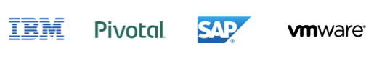

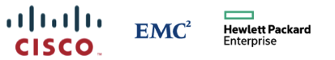
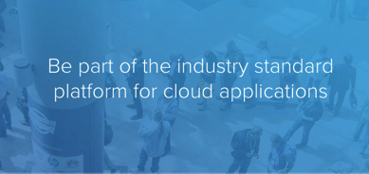
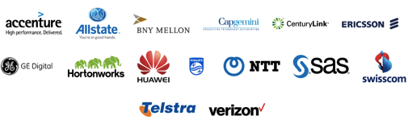
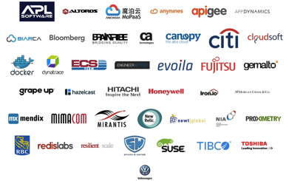
https://www.cloudfoundry.org

Slide 27
THEN
NOW
Java was verbose, complex
Manual, SOAP based SOA
App server sprawl, manual
Complex Ops, Admin, Manage
Low productivity for
Development and ops
Dynamic language productivity
Dynamic, REST microservices
Autoconfig & embed app server
Prod Ops features with a switch
High productivity shared
DevOps responsibility

Slide 28
Spring Boot
Dynamic language productivity with maturity of enterprise Java
Cloud Native: Direct support for Microservices, NetflixOSS++
Fully automated app server configuration and deployment
Production ready Ops metrics out of the box, with a switch

Slide 29

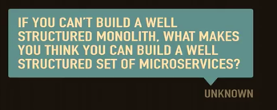
You must be this tall to use µServices…
RAPID PROVISIONING
BASIC MONITORING
RAPID APPLICATION DEPLOYMENT
DEVOPS CULTURE
https://www.flickr.com/photos/gusset/3723961589
http://martinfowler.com/bliki/MicroservicePrerequisites.html

Slide 30
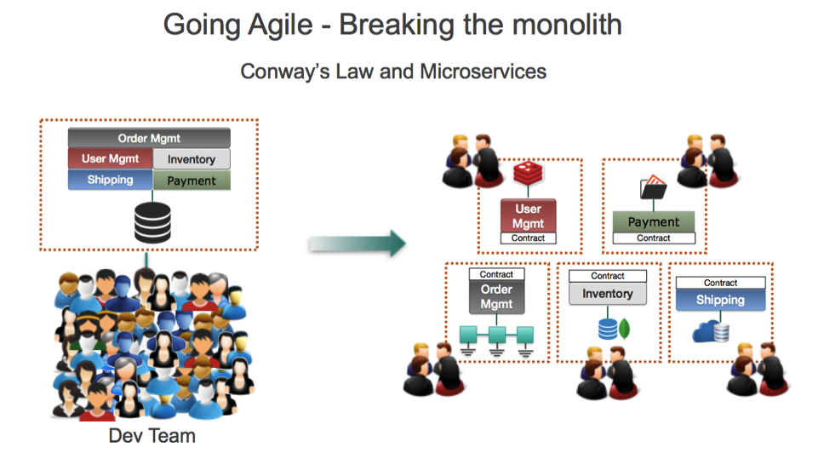

Slide 31
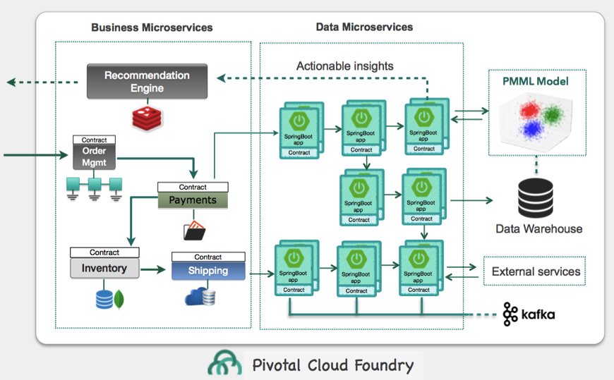

Slide 32

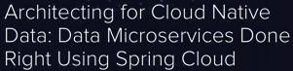
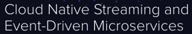
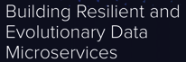
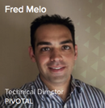

“Pivotal Cloud Foundry is the multi-cloud platform where the cloud native applications live and all the heavy lifting is automated, while Spring Boot consolidates itself as the de facto standard framework for cloud native, and Spring Cloud Dataflow sets the new patterns for cloud native enterprise application and data integration”
https://www.linkedin.com/pulse/cloud-native-architectures-rise-data-microservices-fred-melo

Slide 33
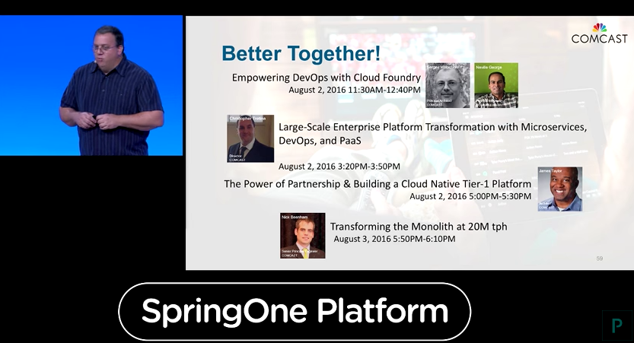
https://springoneplatform.io/

Slide 34
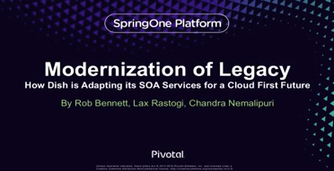
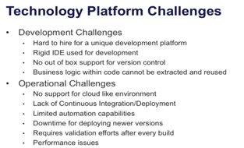
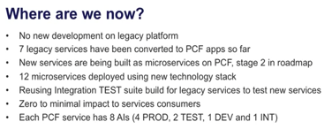



Slide 35




Slide 36


Slide 37
Do what works.
Do the right thing.
Be kind.

Slide 38



Expected outcome for Raytheon
Developer and IT Operation Productivity
Average Developer is able to Provision and Install 50% faster
Average IT Operator can Configure, Deploy, Monitor and Scale App Lifecycle 90% faster.
Support multiple development languages
Software License Savings
Based on Open Source platform and designed to avoid vendor lock-in
Single platform removes the need for complex, multi-vendor contracts
Future-Proof your IT environment
Infrastructure Utilization
App-centric instead of infra-centric approach
Higher packing density equals better workload utilization
Spend time optimizing for business needs, instead of configuration management

Slide 39
Software/Support replaced by platform
Included | Cost Takeout
OS Support | gets you out of the business of managing/updating/paying for OS - eg. RHEL ~$500/Year/VM
App Server Support | Apache Tomcat/tcServer Support - generally priced at $500/core/year
Spring Developer Support | Generally priced at $2000/Dev/Year
Spring OSS Support | Generally priced at $94/core/year
Spring Cloud Services (Eg. Netflix OSS, etc. http://projects.spring.io/spring-cloud/) | The only commercial offering
Software based networking (DNS, reverse proxy, load balancing, SSL termination) | Simplified, less dependent on external network HW
Monitoring Agents | Log capture and collection, APM
Canary style patching/upgrades | Greatly reduced Ops staff (server/admin ratio)
Greater app density per server | Hypervisor license (generally 1 microservice per VM traditionally)

